Slide 1
Section 4
1-AWS Organizations
2- AWS Key Management Service (AWS KMS)
3- Amazon Cognito
4- AWS Shield
5- AWS compliance programs
6- AWS Config
7- AWS Artifact
Dr Fatma Agery

Slide 2
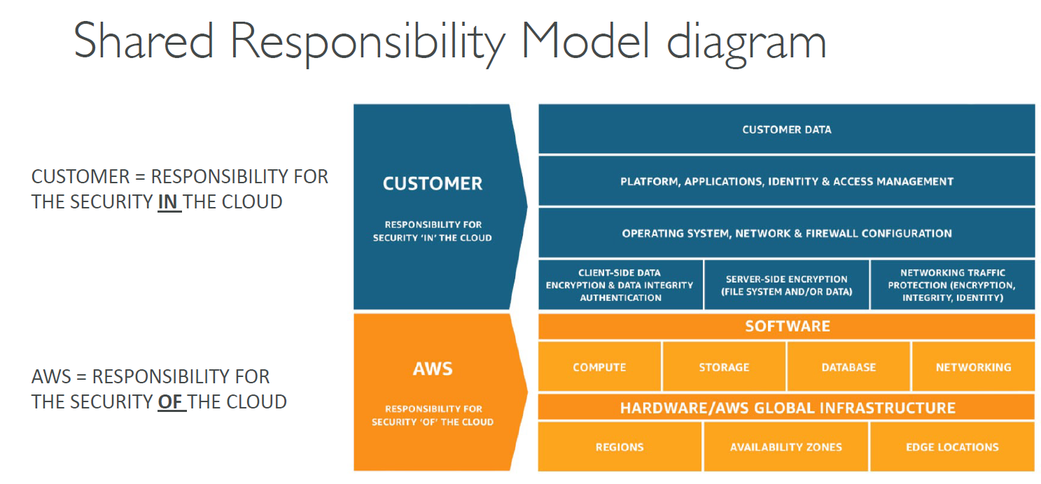

Slide 3
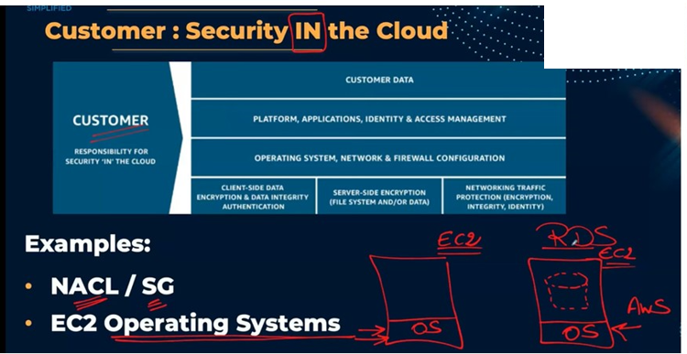

Slide 4
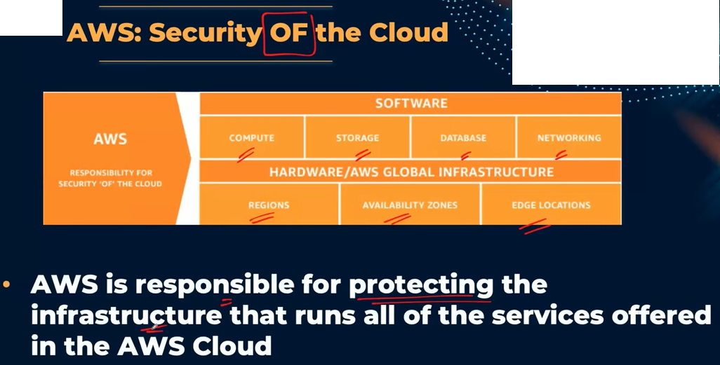

Slide 5

Shared Responsibility Model
AWS responsibilities:
Physical security of data centers
Hardware and software infrastructure
Network infrastructure
Virtualization infrastructure (Instance isolation)

Slide 6
Shared Responsibility Model
Customer responsibilities:
Amazon Elastic Compute Cloud (Amazon EC2) instance operating system
Applications
Security group configuration
OS or host-based firewalls
Network configurations
Account management

Slide 7
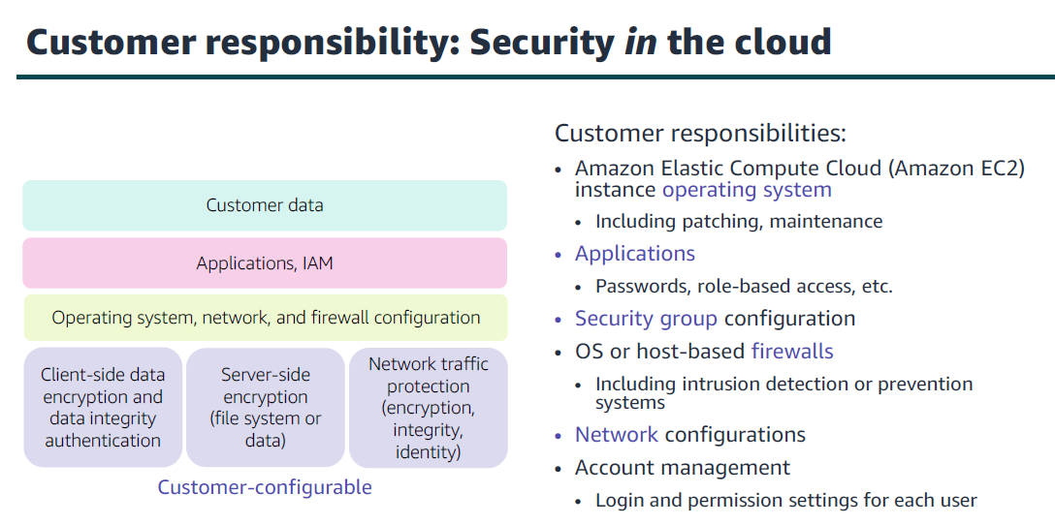

Slide 8
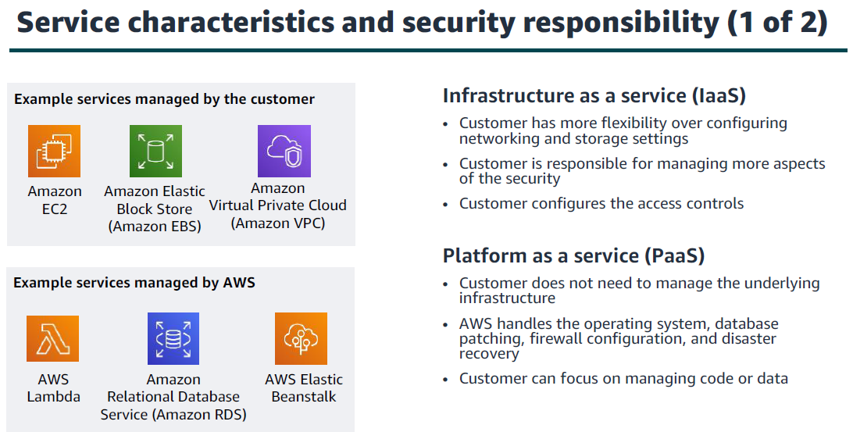

Slide 9
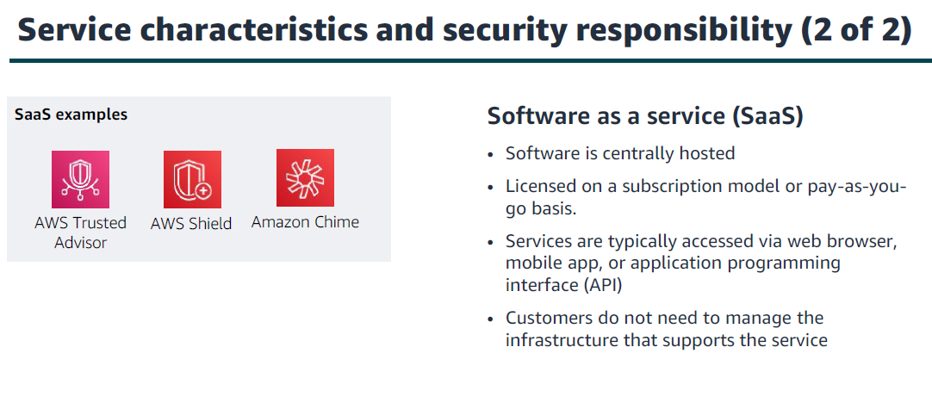

Slide 10
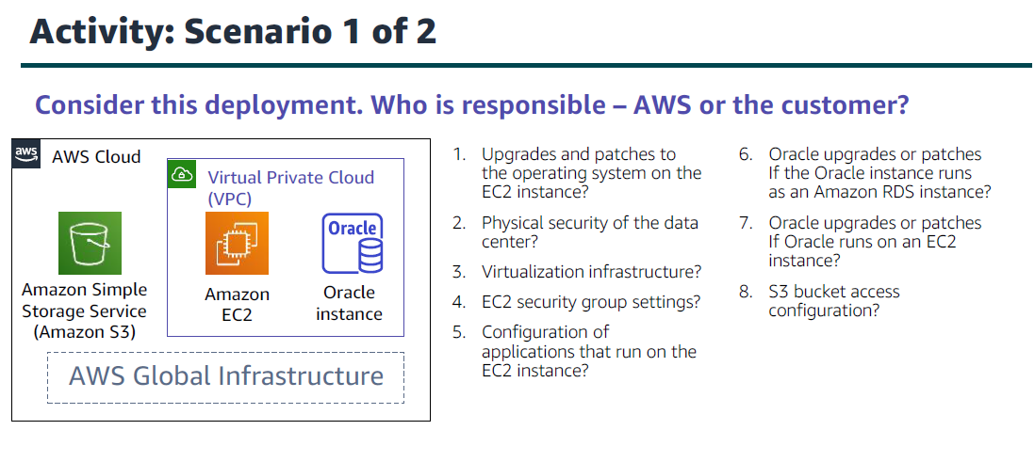

Slide 11
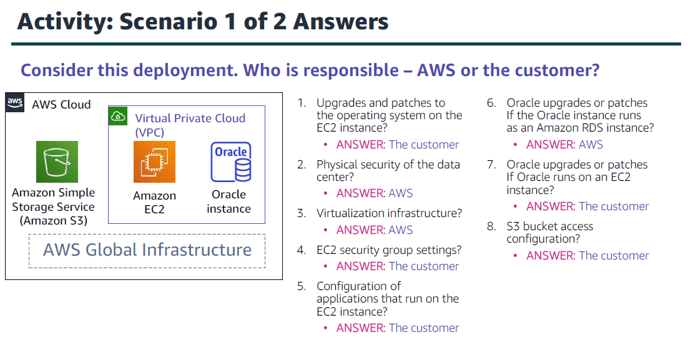

Slide 12
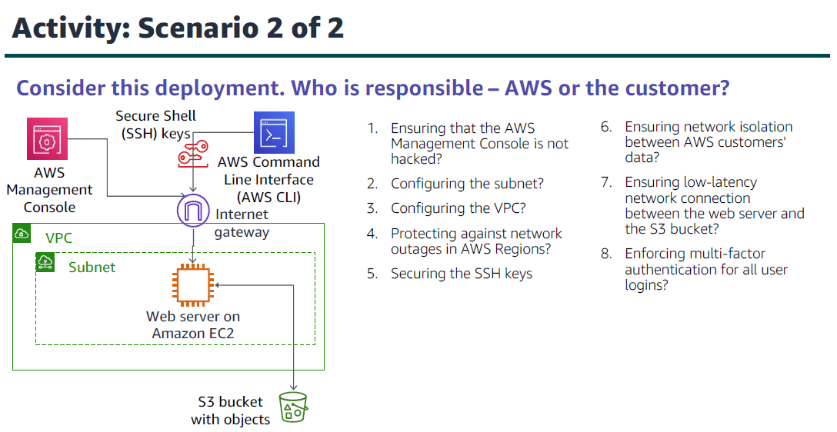

Slide 13
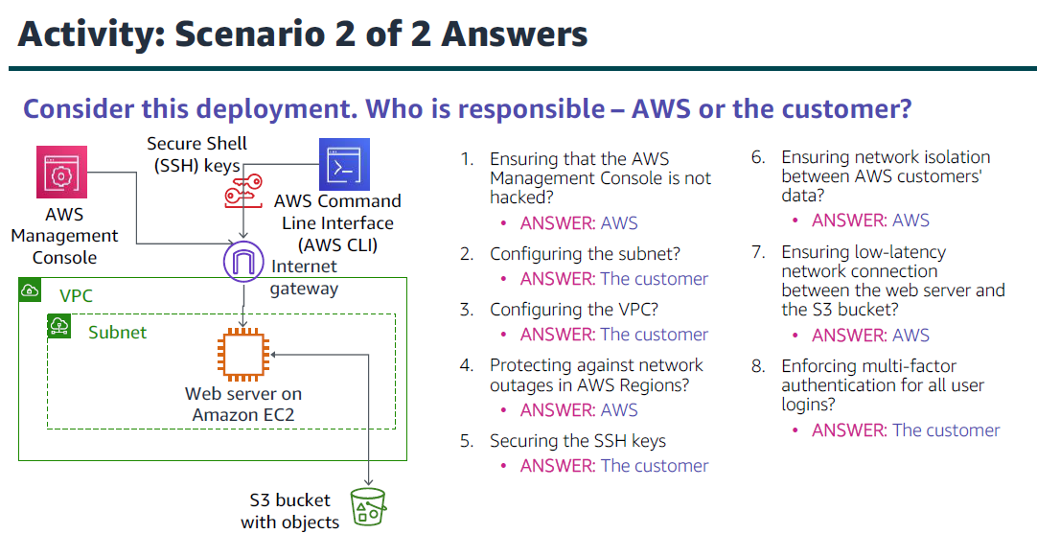

Slide 14
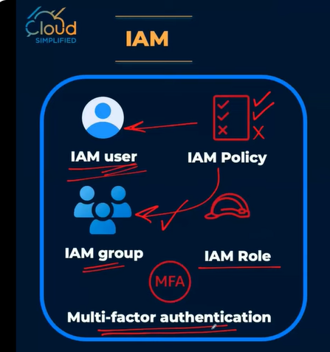
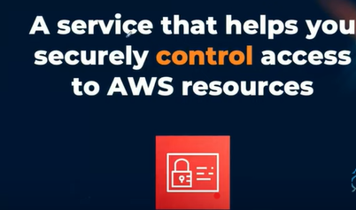

Slide 15
Root user
The root user is the super user within your AWS account.
AWS recommends to use it only for the few tasks that require it..
Change your account settings: email add., root user password.
Restore IAM Permissions

Slide 16
IAM users
An IAM user is an entity that represents human user or a workload who uses the IAM user to interact with AWS
Individual IAM users for each person IAM user

Slide 17
IAM user groups
An IAM user group is a collection of IAM users·
User groups let you specify permissions for multiple users.
Attach IAM Policies to groups rather than to users IAM user group

Slide 18
IAM Policies
Document that allows or denies permissions to AWS services·
Always follow the least privilege security principle

Slide 19
IAM Roles
An IAM role is an IAM identity that you can create in your account that has specific permissions·
Provides temporary security access

Slide 20
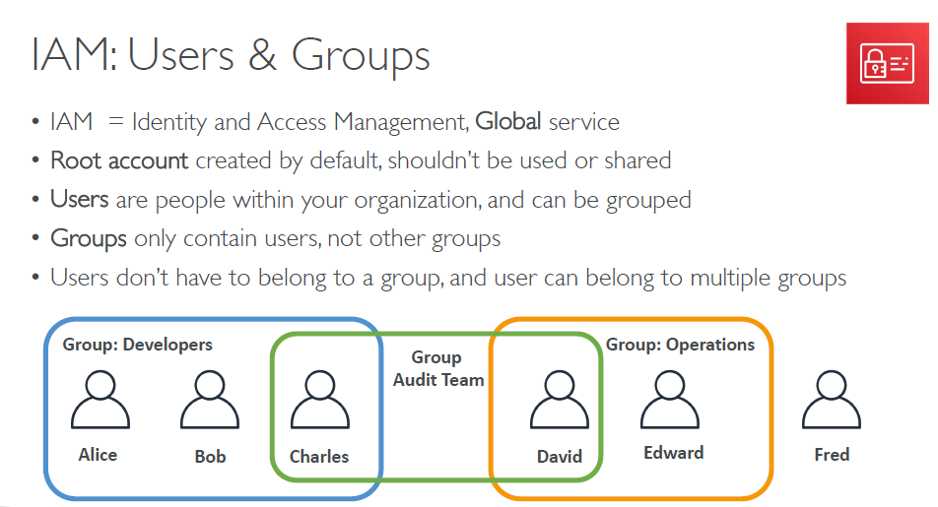

Slide 21
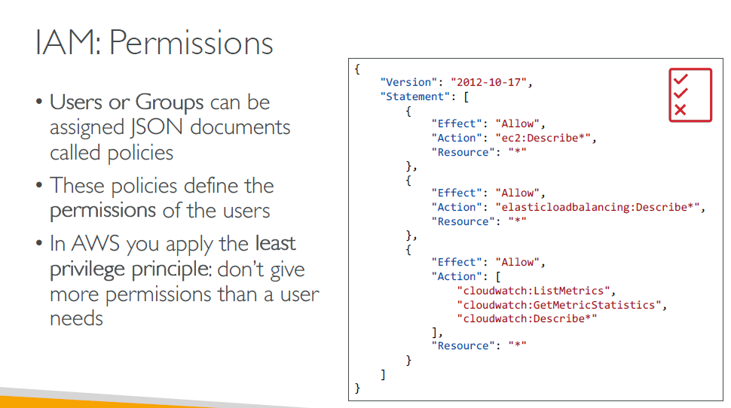

Slide 22
IAM Users, Groups, and Roles
IAM = Identity and Access Management, Global service
Allows you to manage access to AWS services and resources securely. You can create and manage AWS users and groups and use permissions to allow or deny access.
Root account created by default, shouldn’t be used or shared
Users are people within your organization, and can be grouped
Groups only contain users, not other groups
Users don’t have to belong to a group, and user can belong to multiple groups

Slide 23
IAM Users, Groups, and Roles
Roles are assigned to an AWS services
It allows services to perform actions and access AWS
Permissions are assigned to AWS services with IAM Roles
Ex:
EC2 Instance Roles
Lambda Function Roles

Slide 24
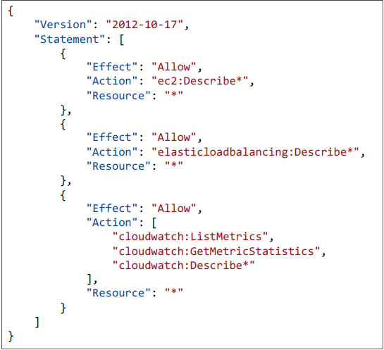
IAM Permissions
Permissions assigned to users, groups, and roles are defined by the Policies
Policies are written in a JSON document
Don’t give more permissions than a user needs (Least Privilege Principle)

Slide 25
IAM Permissions
Consists of:
Version: policy language version, always include “2012-10-17”
Statement: one or more individual statements (required)

Slide 26
IAM Permissions
Statement consists of:
Effect: whether the statement allows or denies access (Allow, Deny)
Action: list of actions this policy allows or denies
Resource: list of resources to which the actions applied to
Note: “*” Means Anything

Slide 27
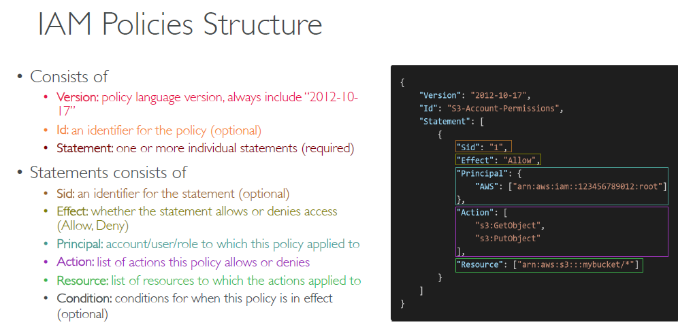

Slide 28
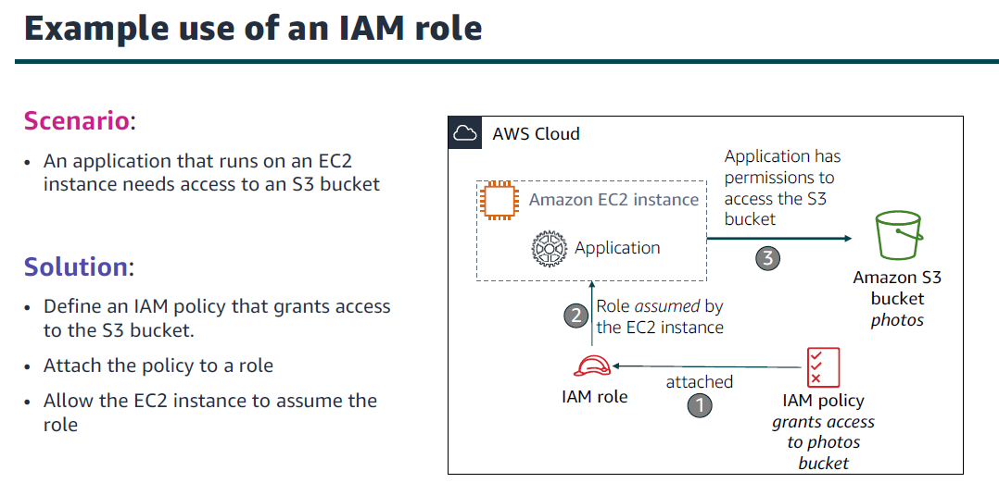

Slide 29
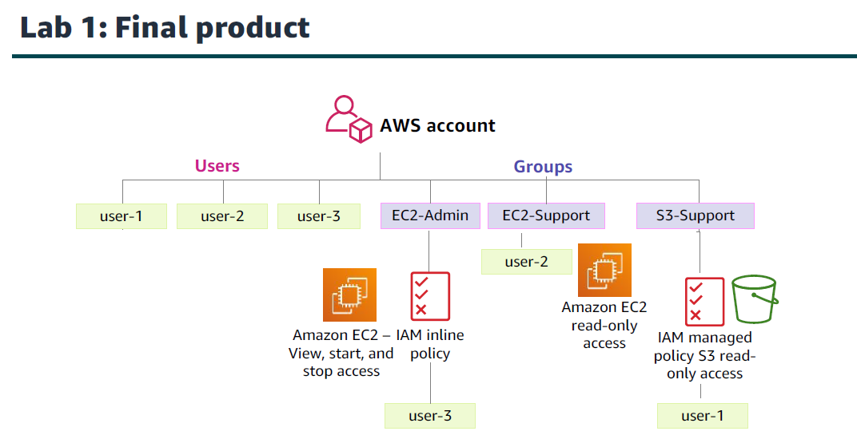

Slide 30
Securing a new AWS account: Account root user
Step 1: Stop using the account root user as soon as possible.
Securing a new AWS account: MFA
Step 2: Enable multi-factor authentication (MFA).
Securing a new AWS account: AWS CloudTrail
Step 3: Use AWS CloudTrail.
Securing a new AWS account: Billing reports
Step 4: Enable a billing report, such as the AWS Cost and UsageReport.

Slide 31
Best practices to secure an AWS account:.
Secure logins with multi-factor authentication (MFA).
Delete account root user access keys..
Create individual IAM users and grant permissions according to the principle of least privilege..
Use groups to assign permissions to IAM users..
Configure a strong password policy..
Delegate using roles instead of sharing credentials..
Monitor account activity by using AWS CloudTrail.

Slide 32
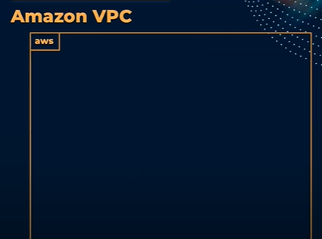

Slide 33
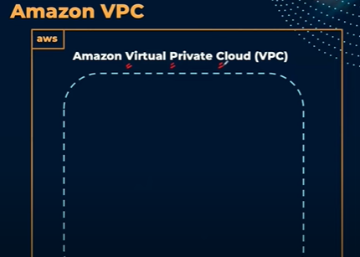

Slide 34
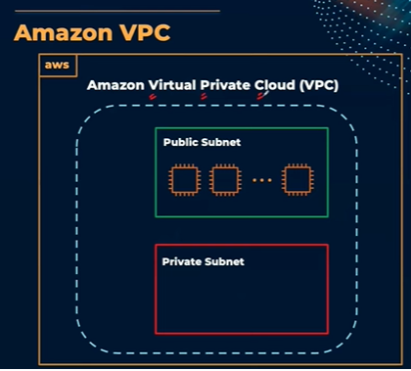

Slide 35
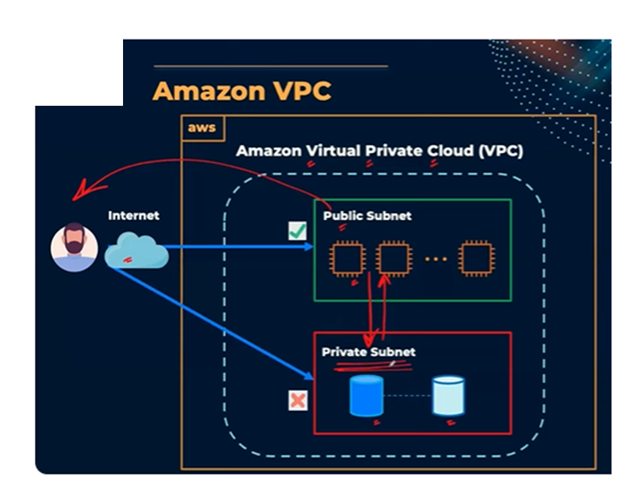

Slide 36
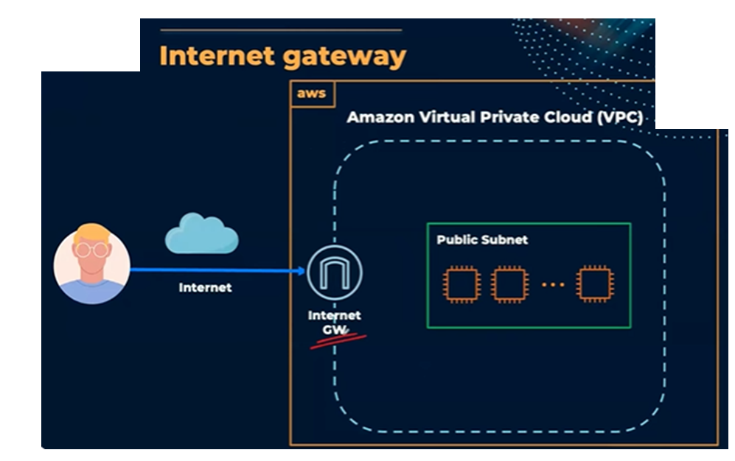

Slide 37
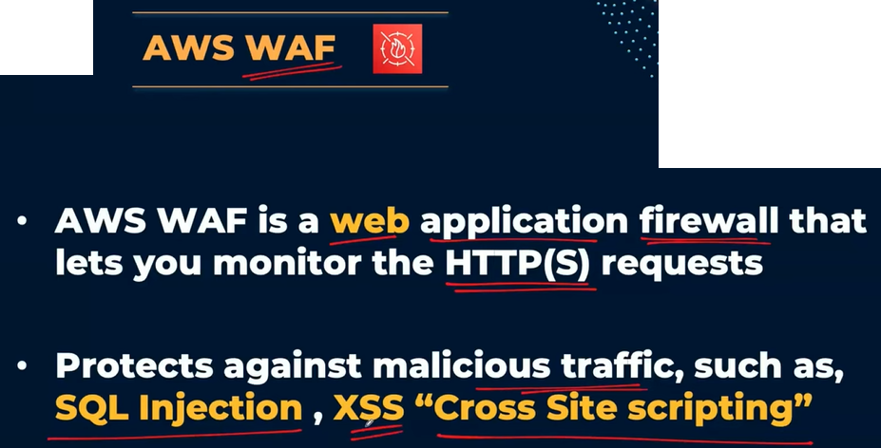

Slide 38
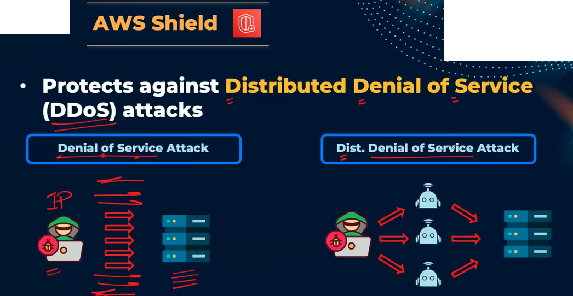

Slide 39
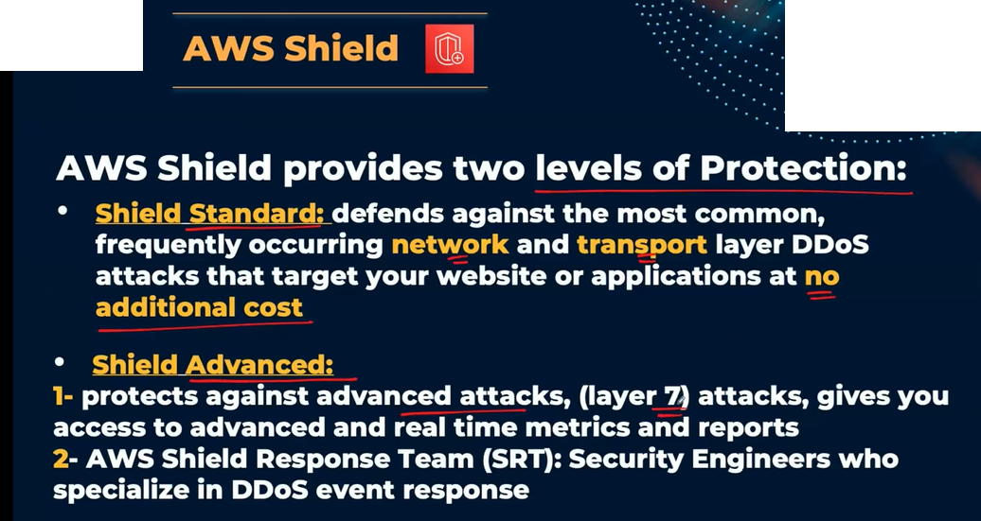

Slide 40
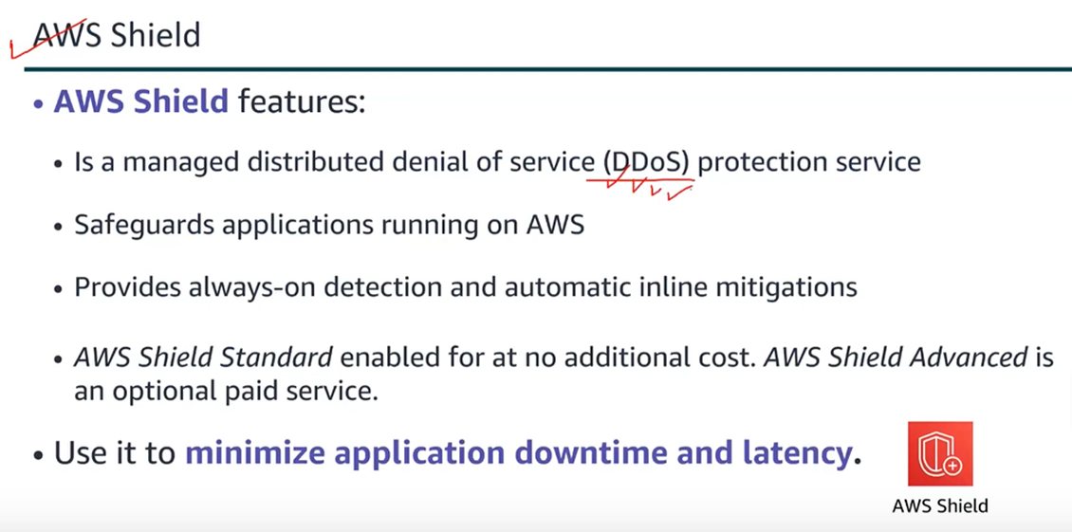

Slide 41
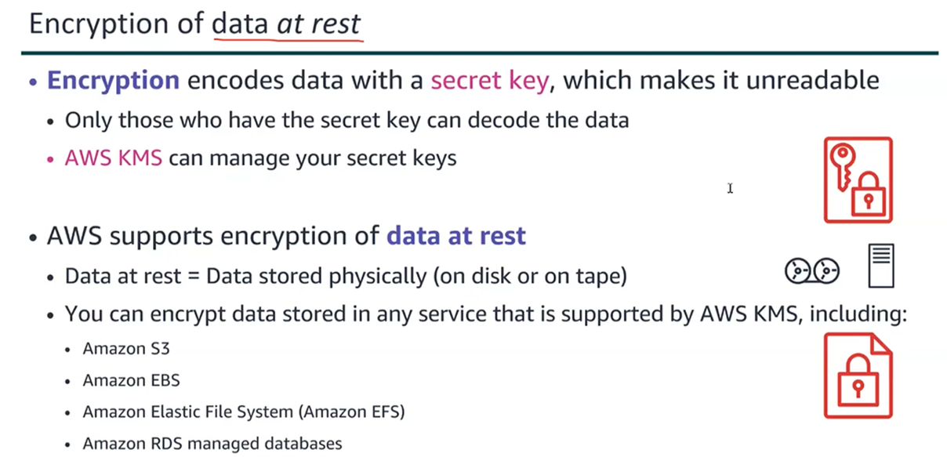

Slide 42
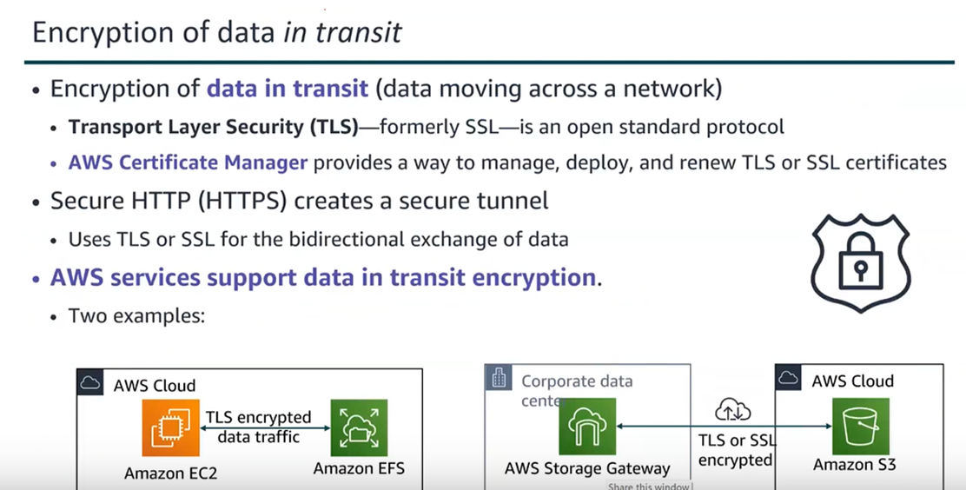

Slide 43
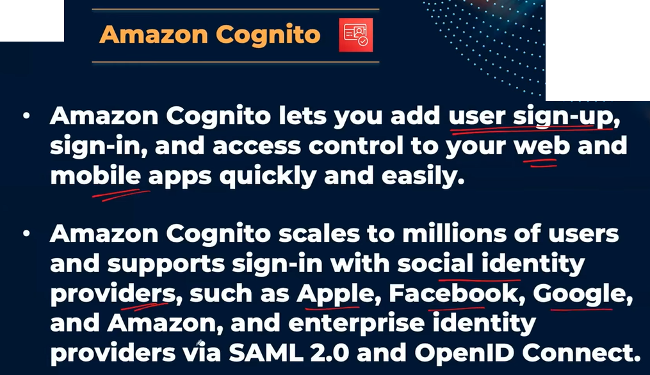

Slide 44
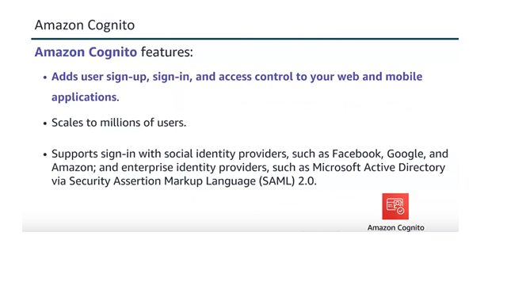

Slide 45
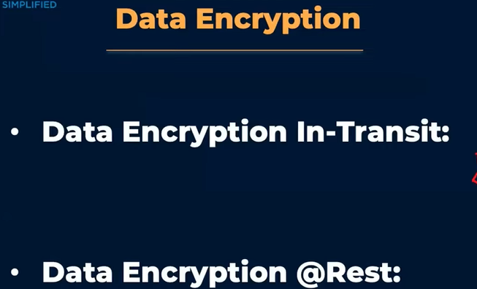

Slide 46
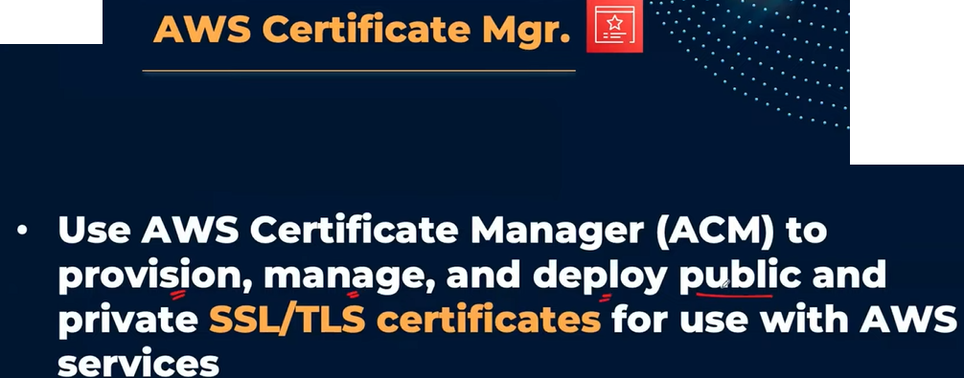

Slide 47
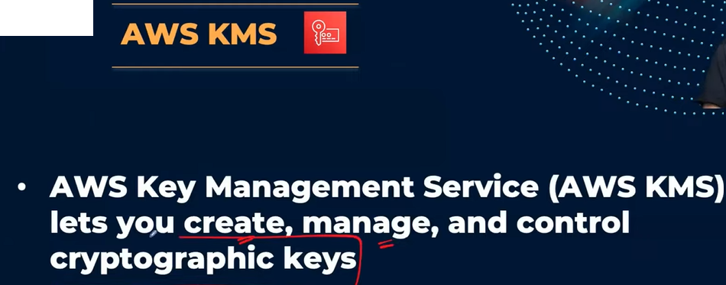

Slide 48
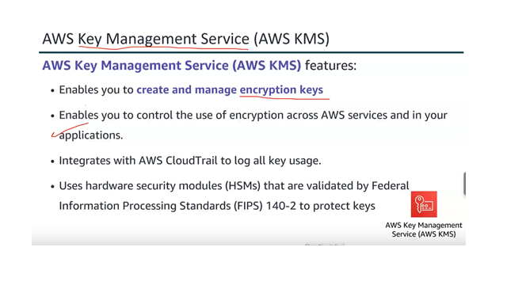

Slide 49
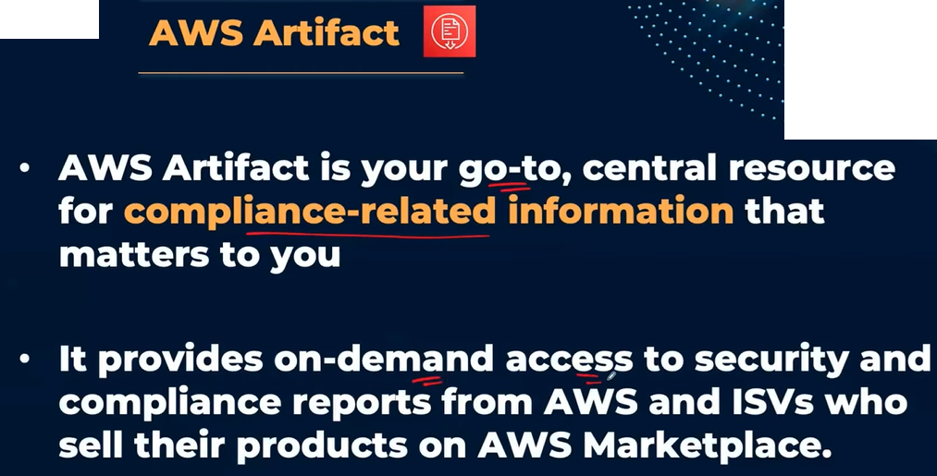

Slide 50
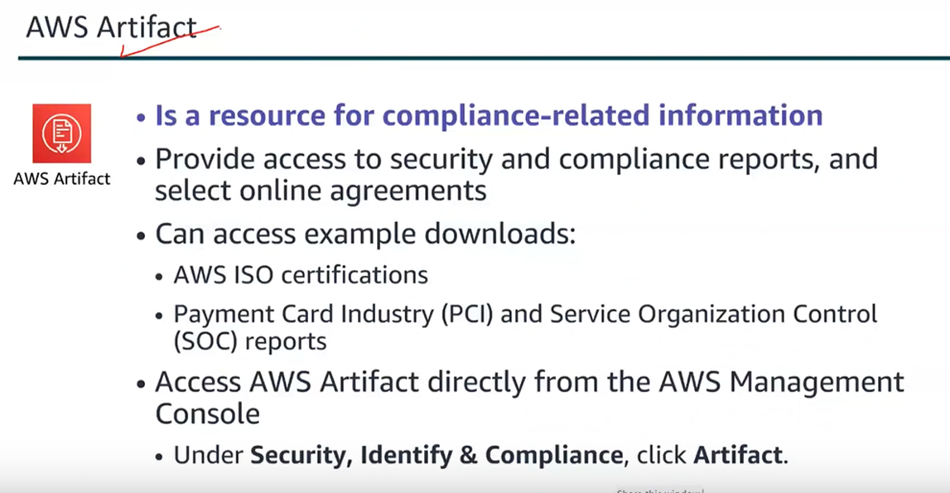

Slide 51
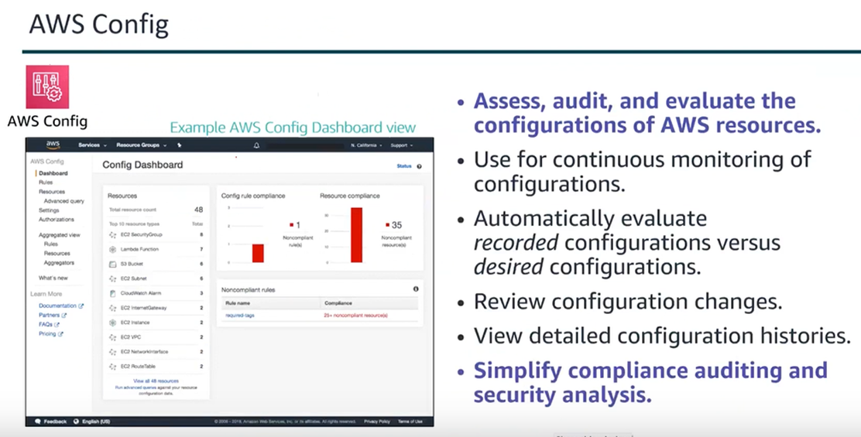

Slide 52
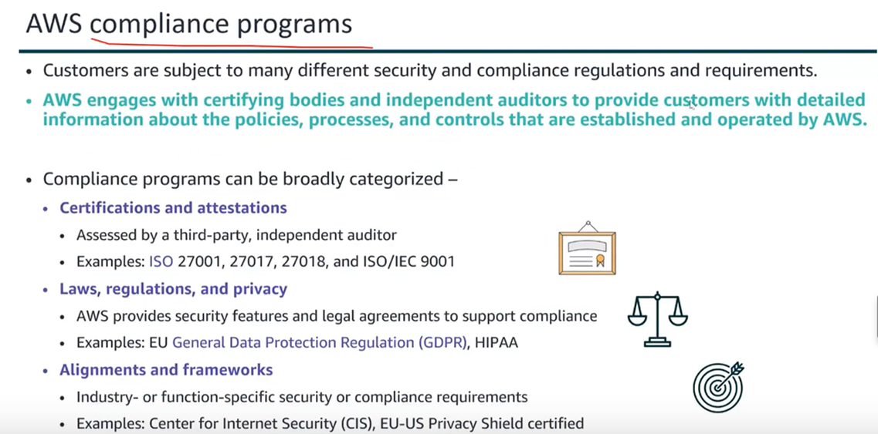

Slide 53
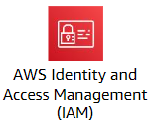
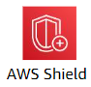
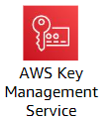
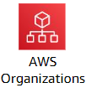
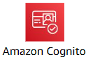
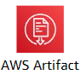
Security, identity, and compliance Service Category
IAM: Control access to AWS services for users.
AWS Shield: Protect against DDoS attacks.
AWS Organizations: a service that enables you to centrally manage multiple AWS accounts
AWS KMS: enables you to create and manage keys.
AWS Cognito: A user authentication and management service that enables developers to add sign-up, sign-in, and access control features to their applications
AWS Artifact: provides on-demand access to AWS security and compliance reports and select online agreements.

Slide 54
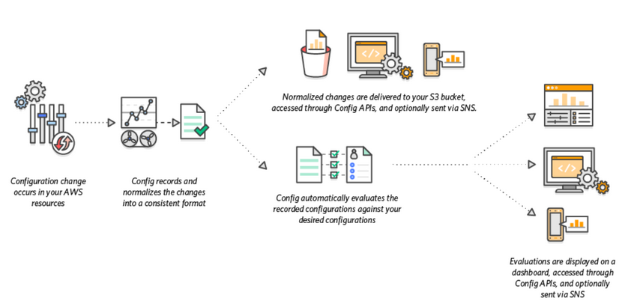

Slide 55
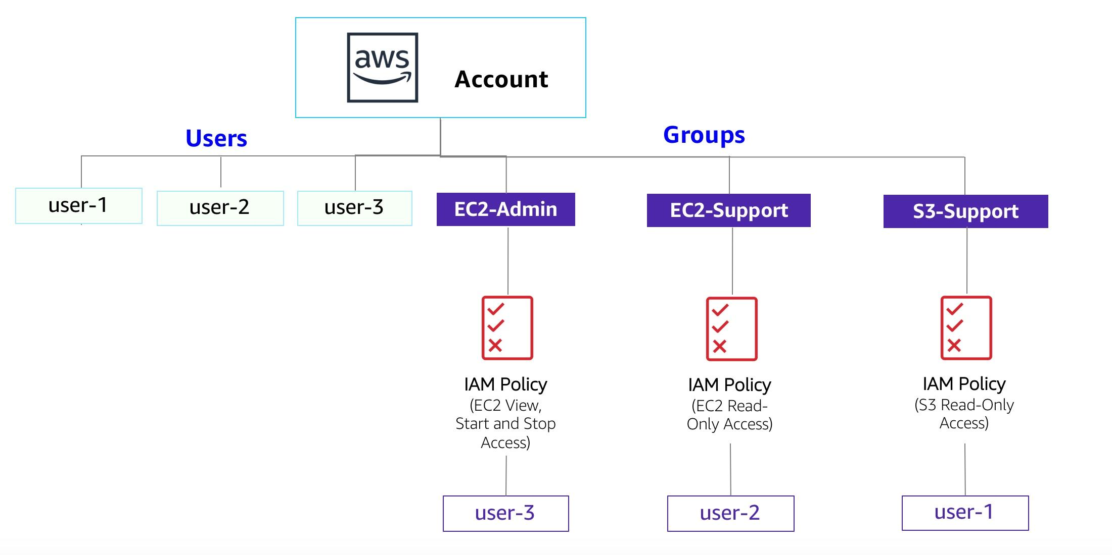
LAB SCENARIO

Slide 56
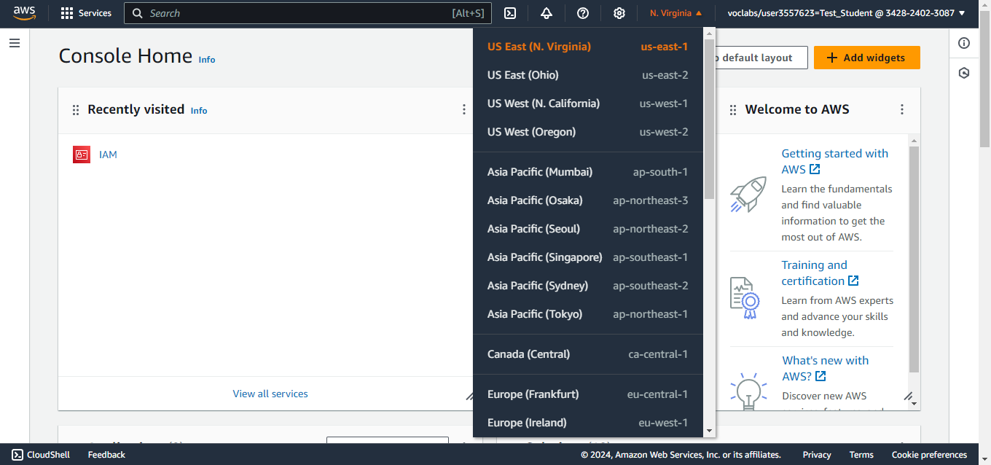
OUTLINE
Available Regions

Slide 57
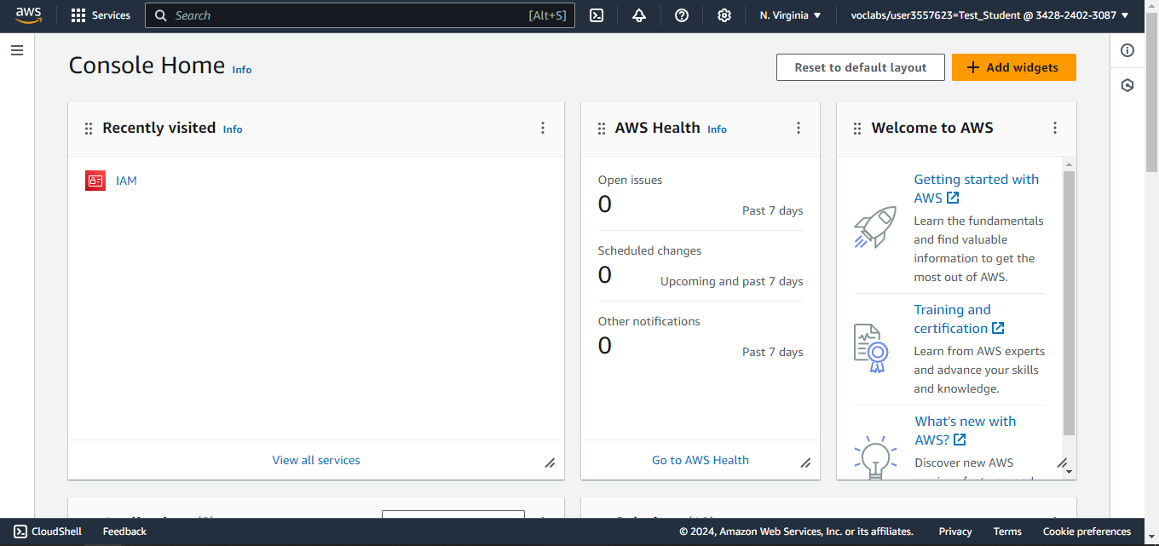
OUTLINE
Step 1: search for IAM Service

Slide 58
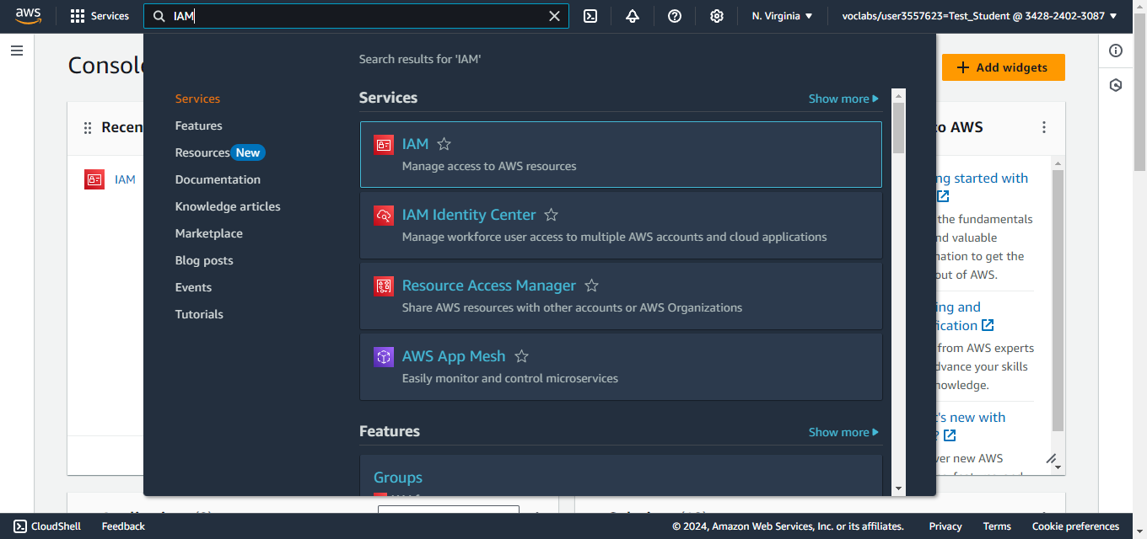
OUTLINE
Step 1: search for IAM Service

Slide 59

IAM is a Global Service

Slide 60

Step 2: Explore Users (user-1)

Slide 61

Step 2: Explore Users (user-2)

Slide 62

Step 3: Explore Groups (No users Assigned)

Slide 63

Step 3: Explore Groups (EC2-Support group)

Slide 64

Step 4: Explore Permissions for this group

Slide 65

AmazonEC2ReadOnlyAccess Policy

Slide 66

JSON Document

Slide 67

Step 5: Add users to groups (S3-Support group)

Slide 68

Step 5: Add users to groups (S3-Support group)

Slide 69

Step 5: Add users to groups (EC2-Support group)

Slide 70

Step 5: Add users to groups (EC2-Support group)

Slide 71

Step 5: Add users to groups

Slide 72

Step 5: Test Permissions (login as user-1)

Slide 73

user-1 is IAM user

Slide 74

user-1 has “S3-Read-Only-Access” Permission

Slide 75

user-1 doesn’t have permission to access EC2

Slide 76

user-1 doesn’t have permission to access EC2

Slide 77

Login as user-2

Slide 78

user-2 doesn’t have permission to access S3

Slide 79

EC2 is a Regional Service

Slide 80

Change the region to access EC2 instances

Slide 81

user-2 has “EC2-Read-Only-Access” Permission

Slide 82

user-2 cannot Stop EC2 instance

Slide 83

Login as user-3

Slide 84

user-3 can Stop EC2 instance

Slide 85

user-3 can Stop EC2 instance

Slide 86

user-3 can Stop EC2 instance

Slide 87

The instance has been stopped

Slide 88


Slide 89


Slide 90


Slide 91


Slide 92


Slide 93


Slide 94


Slide 95

Notes:
revoke all permissions on the aws account root user

Slide 96

Notes:
MFA

Slide 97

Notes:
false

